Slide 1
HTML5 – Mid and Advanced
Full-stack HTML5 Application
18th of September, 2013

Slide 2
“Computers themselves, and software yet to be developed, will revolutionize the way we learn.”
-- Steve Jobs

Slide 3
Full-stack HTML5 Application
Technology stack:
  Yii : 'protected/vendor/yii'
  Backbone.JS : 'app/js/libs/backbone/backbone'
  Underscore.JS : 'app/js/libs/underscore/underscore'
  RequireJS : 'app/js/libs/require/*'
  jQuery : 'app/js/libs/jquery/jquery-1.7.1.min'
  jQuery UI : 'app/js/libs/jquery-ui/jquery.ui.core'
  MarionetteJS : 'app/js/libs/backbone/backbone.marionette'
  Backbone-relational : 'app/js/libs/backbone/backbone-relational'
  modelbinding : 'app/js/libs/backbone/backbone.modelbinding'
  visualsearch : 'app/js/libs/app/visualsearch'
  json : 'app/js/libs/utils/json2',
  bootstrap : 'app/js/libs/bootstrap/*'

Slide 4
Application Logic
Commenting platform:
- list posts both as anonymous user and logged in user
- add, modify, delete comments based on user’s login
- add, modify users
- login / logout (super / 1q2w3e)
Future improvements:
- list comments for each post
- add, modify, delete comments

Slide 5

Application Logic

Slide 6
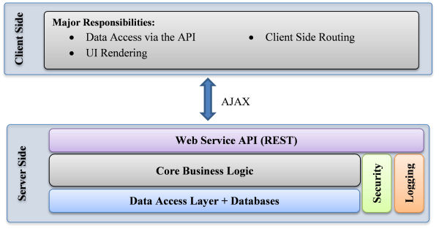
Application Architecture
The server-side logic (DB manipulations, RESTful resources etc.) is handled by Yii Framework
The client-side code is structured in an MVC, Single Page Application fashion through Backbone.JS

Slide 7
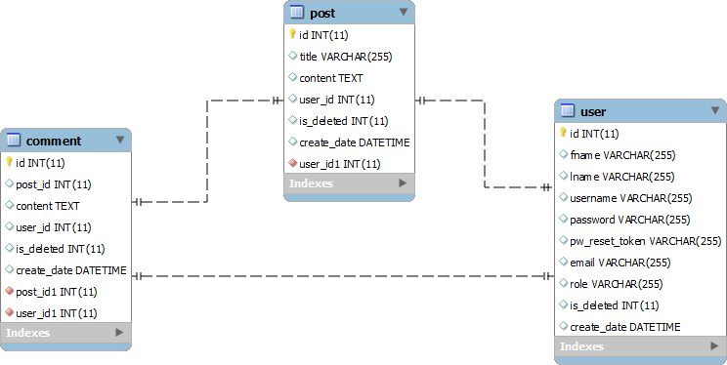
Application Database

Slide 8
Application Database

Slide 9
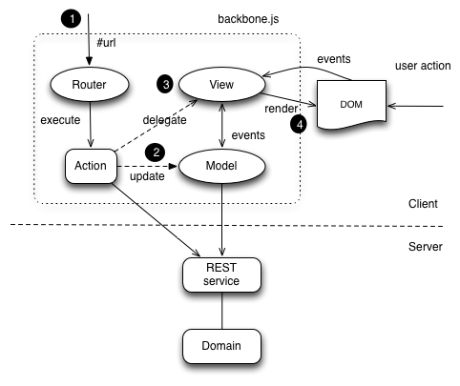
Single Page Application & Backbone.JS
Entry point: main.php
Yii Framework
Notes:
1 –> routing support within the single page application
2 and 3 –> delegate control to views or execute actions on the models
4 –> event-driven interaction between views and data

Slide 10
Single Page Application & Backbone.JS

Slide 11
Modularity – Require.JS
The JavaScript code is separated into modules (some sort of #include/import/require)
The modules and their nested dependencies can be asynchronously loaded

Slide 12
Modularity – Require.JS

Slide 13
Templating – Underscore.JS
Instead of manipulating the DOM directly and mix HTML with JavaScript code, HTML markups fragments can be created

Slide 14
Templating – Underscore.JS

Slide 15
Thank you!
Cosmin Nicula
Blog: http://cosmi.nu
GitHub: https://github.com/cosminnicula
Twitter: https://twitter.com/cosminnicula

